Slide 1
SD: Architecture
04-Apr-18 | Start
Appendix
Online

Slide 2
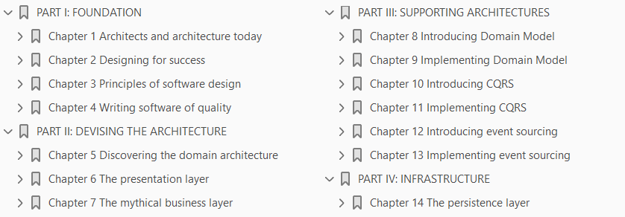
Architecting
Ch | Date
1 | ddmmmyy
2
3
4
5
6
7
8
Microsoft .NET - 2014 Architecting Applications for the Enterprise

Slide 3

Architects and Architecture today
1

Slide 4
Intro
At the very beginning of the computing age, the costs of hardware were largely predominant over the costs of software.
Some decades later, we look around and find the situation to be radically different.
The industry made incredible progress, and hardware costs have fallen dramatically.
Software development costs, on the other hand, have risen considerably, mostly because of the increasing complexity of custom enterprise software development.
This situation has created the need for a set of precepts to guide engineers in the design of such systems.
Appropriated from the construction industry, the term architecture has become the common way to describe the art of
Planning
Designing
implementing
software-intensive systems.

Slide 5
Intro |
When the two of us were teenagers the “Love Is” comic strip (http://www.loveiscartoon.com) was at its peak of popularity. Each installment contained a piece of teenage wisdom about love.
One cartoon said something like, “Love is a necessity, not a luxury.”
Well, that’s precisely the point with architecture in software.
In this first chapter, we try to share our vision of architecture and how you figure it out and then implement it.
In doing so, we’ll touch on the role that architects play in the process and the basic facts we’ve seen ruling the mechanics of software projects.
Needless to say, our experience is just ours. Although we’ve been working on some interesting projects of various sizes, our experience is still limited to what we’ve seen and the mistakes we’ve made.
Nonetheless, we like to think of this book as the excuse for you to start a longer and more focused conversation within your team about the way you actually build things that work.

Slide 6
Note
Although some definitions you find in this book come from international standards, others reflect our personal opinions, experiences, and feelings.
We will cover the well recognized best practices on architecture, but we will also comment from own experience.
We hope this combination will help you relate the, sometime dry, international standards to what you will find in the real world.

Slide 7
What’s software architecture, anyway?
One of this book’s authors had, in the past, frequent interaction with an architecture studio.
One day, a question popped up for discussion: What’s architecture? Is it an art? Or is it just building for a client?
In software, the term architecture precisely refers to building a system for a client.
That’s it: no more and no less. This said, finding a more detailed description of what’s involved in building a system for a client is the toughest part.
We often wonder whether there’s really a point in it.
A million times we ask ourselves this question, and a million times we find the same answer.
It’s hard, but let’s give it a try.
At worst, it ends up being a brainstorming session, and brainstorming is never a bad thing.
So let’s try to clarify what “software architecture” is or, at least, what we intend it to be.

Slide 8
Note
The term architecture goes hand in hand with the term architect.
Architect is a role, and we’ll discuss later in the chapter the responsibilities we associate with the role of an architect.
However, the term architect still makes people think of a profession.
Unfortunately, the professional figure behind the term is not universal.
That title is qualified by adjectives such as
Enterprise
Solution
Security, and so forth
Unless we specify otherwise, we mean the professional figure sometimes described as a software architect or solution architect.

Slide 9
Applying architectural principles to software
Many of us grew up as software experts first thinking that software is somehow related to the world of construction, and later fighting that notion.
The analogy was first used in the software industry to express the need to plan and design before building computer programs.
However, a fundamental difference exists between designing and building habitable structures and designing and building usable software systems.
Software exists to automate business processes and human actions; civil architecture artifacts exist as a service to the community.
Usually, civil architecture services are planned and realized with best intentions and to be useful to the greatest number of people.
Their aim isn’t to satisfy just a few stakeholders.
In addition, civil architecture artifacts are costly and complex enough that nobody ever thinks of making variations to the approved project on the fly.
Or, at least, variations occur only occasionally.

Slide 10
Applying architectural principles to software |
Things go differently in software.
Software is typically created for a small group of stakeholders; some of them pay from their own pocket to get something that helps their organization function better.
Requirements, therefore, are continuously refined, added, removed, and reprioritized.
This approach to software requires agility and doesn’t wed well with the idea of a big upfront design like you have in civil architecture.
In a nutshell, today the architectural parallelism between construction and software is not as close as it was a couple of decades ago.
However, many dictionaries still list a software-related definition of the term “architecture.”
And software architecture is described as “the composition, integration, and interaction of components within a computer system.”
It is certainly a definition everybody would agree on. But, in our opinion, it is rather generic and abstract.
Hence, it doesn’t work.
We think that software professionals should agree on a more detailed explanation that breaks down that definition into smaller pieces and puts them into context.

Slide 11
Defining the architecture from a standard viewpoint
Many seem to forget that a standard definition for software architecture exists.
More precisely, it’s been around since September 2000 when the American National Standards Institute/Institute of Electrical and Electronics Engineers (ANSI/IEEE) standard 1471, “Recommended practice for architectural description of software-intensive systems” was released.
Over the years, the document also became International Organization for Standards/International Electrotechnical Commission (ISO/IEC) standard 42010.
Those interested in reading the full standard can link to the following URL: http://www.iso.org/iso/iso_catalogue/catalogue_tc/catalogue_detail.htm?csnumber=45991.
Software architecture is concerned with the organization of any software-intensive system that solves a problem and achieves its mission in full respect of stakeholders’ concerns.
In extreme synthesis, this is the official definition of the term software architecture you get from international standards papers.
Stakeholders are defined as all individuals interested or concerned about the building of the system.
The list includes the builders of the system (architects, developers, testers) as well as the acquirer, end users, analysts, auditors, and chief information officers (CIOs).
Concerns are defined as any interests that stakeholders can have about the system and the influence they exercise on the system, whether developmental, technological, operational, organizational, economic, or legal.

Slide 12
Note
We know that a lot of people get scared when they run across acronyms like ISO, ANSI, and the like.
We also tend sometimes to skip these references because they, well, just sound boring and mindful of the abundant doses of theory we received at university.
Anyway, standards papers are full of information we just agree with.
In this chapter, we reference standards mostly to say that in some areas (such as, processing user requirements) a lot has been done and it has been done well enough to reuse it.

Slide 13
Diagram of a software-intensive system
Figure 1-1 summarizes the core part of the official diagram that describes software architecture according to papers recognized by the ISO, IEC, and IEEE.
A system lives in a context, and this context influences the design of the system by driving some developmental and operational decisions.
Although current standards envision the system as a composition of interconnected components, architecture also establishes some firm points that are hard to modify later.
In a way, expressing software development in terms of architecture boils down to making some key decisions that affect the development life cycle and, ultimately, the quality of the resulting system.

Slide 14
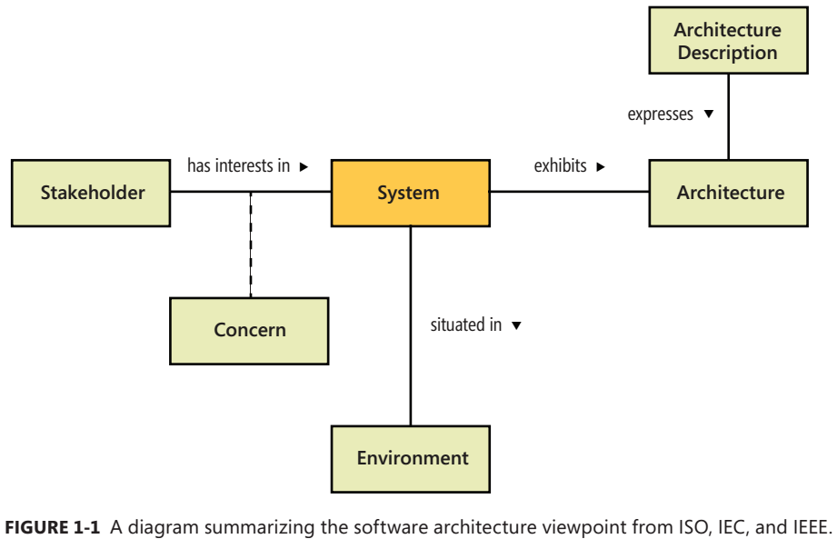
Figure 1-1

Slide 15
Our very own blend of software architecture
When new people join our companies, we offer them—regardless of skills and roles—our personal view of software architecture.
We’re Italian, and in Italy we’re rigidly serious about coffee.
When it comes to an espresso, there are not that many different types of coffee.
The only recognized categorization is between a good espresso and a not-so-good espresso.
But when we enter Starbucks, like everybody else, we have our own favorite blend of coffee.
We like to extend the coffee analogy to software architecture.
As with espresso, in this world we see only good architecture and not-so-good architecture.
To keep with the analogy, we’re restricted to just architecture that results in a working system.
We don’t consider here bad architecture resulting in failing systems, just like we don’t drink bad espresso!
When served bad espresso, an Italian doesn’t complain, he just walks out of the bar and shares the appropriate (and respected) feedback.
When it comes to laying out architecture, just like we do at Starbucks, we have our own vision of it.
Our vision can be depicted by a plain graph with nodes and arcs, but we feel it expresses how we think and how we work. (See Figure 1-2.)

Slide 16
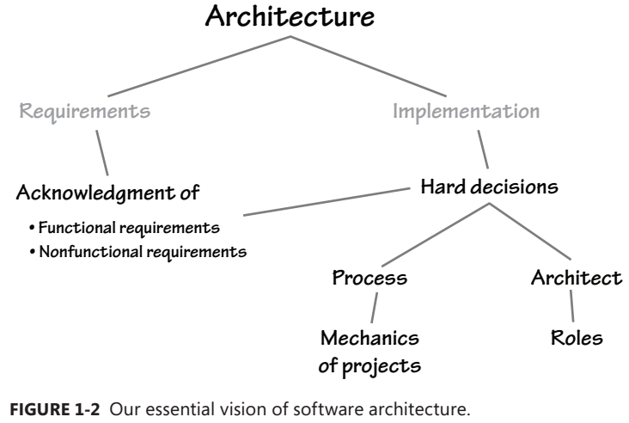
Figure 1-2

Slide 17
Acknowledging requirements
The mission of the system is expressed through a set of requirements.
These requirements ultimately drive the system’s architecture.
In rather abstract terms, a requirement is a characteristic of the system that can be either
functional or
nonfunctional
A functional requirement refers to a behavior the system must supply to fulfill a given scenario.
A nonfunctional requirement refers to an attribute of the system explicitly requested by stakeholders.
Are the definitions of functional and nonfunctional requirements something standard and broadly accepted?
Actually, an international standard to formalize quality characteristics of software systems has existed since 1991.

Slide 18
A quick look at the ISO/IEC 9126 standard
As a matter of fact, failure to acknowledge requirements is one of the most common causes—often, the primary cause—that leads straight to the failure of software projects.
The ISO/IEC 9126 standard defines a general set of quality characteristics required in software products.
The standard identifies six families of quality characteristics, articulated in 21 subcharacteristics.
The main families are
Functionality reliability usability
Efficiency maintainability portability
Table 1-1 explains them in more detail and lists the main subcharacteristics associated with each.
Subcharacteristics are of two types: external and internal.
An external characteristic is user oriented and refers to an external view of the system.
An internal characteristic is system oriented and refers to an internal view of the system.
External characteristics identify functional requirements; internal characteristics identify nonfunctional requirements.
The newer ISO/IEC 25010 standard supersedes ISO/IEC 9126 and was issued in March 2011.
ISO 25010 has eight product-quality characteristics and 31 subcharacteristics.

Slide 19
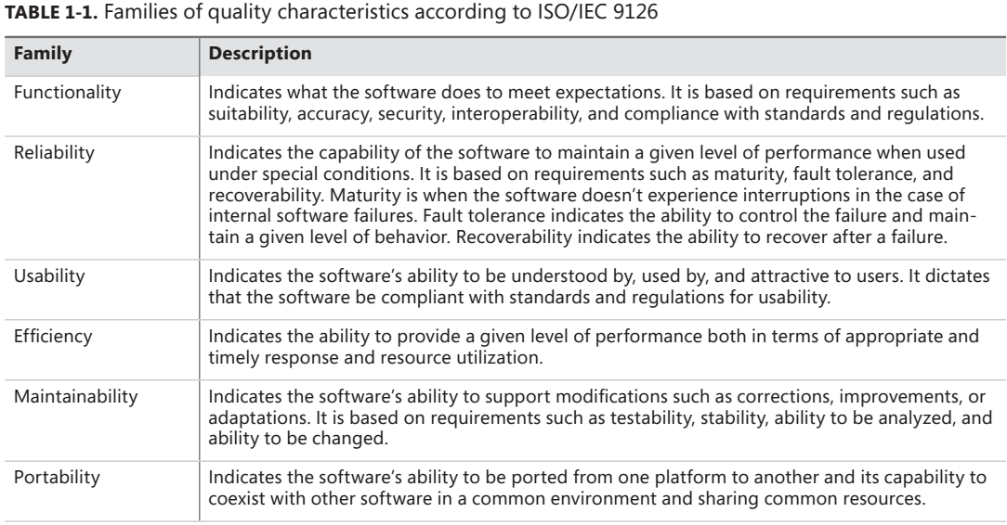
Table 1-1

Slide 20
Functional requirements

Slide 21
Nonfunctional requirements

Slide 22
Gathering requirements

Slide 23
How we deal with requirements

Slide 24
What’s architecture and what’s not

Slide 25
Defining the borderline between architecture and implementation

Slide 26
The science of hard decisions

Slide 27
Hard decisions are everywhere

Slide 28
Context makes decisions hard

Slide 29
The architecture process

Slide 30
Upfront architecture

Slide 31
Emerging architecture

Slide 32
Emerging architecture with upfront analysis

Slide 33
Who’s the architect, anyway?

Slide 34
An architect’s responsibilities

Slide 35
Acknowledging the requirements

Slide 36
Breaking down the system

Slide 37
Identifying and evaluating technologies

Slide 38
Formulating specifications

Slide 39
The role of the architect

Slide 40
How many types of architects do you know?

Slide 41
Architect roles

Slide 42
Common misconceptions about architects

Slide 43
The architect is an analyst

Slide 44
The architect is a project manager

Slide 45
The architect never writes any code

Slide 46
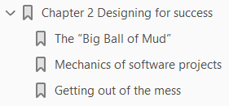
Designing for success
2

Slide 47
Intro

Slide 48
The “Big Ball of Mud”

Slide 49
Mechanics of software projects

Slide 50
Getting out of the mess

Slide 51
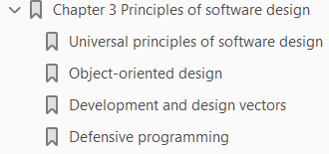
Principles of software design
3

Slide 52
Intro
A popular saying in software development is that good architecture is architecture in which all hard-to-change decisions turn out to be right.
Software architecture is about implementing behavior around pillars.
Changing pillars on the go is obviously problematic, but it might become necessary if the pillars fail to support enough weight, or if you think of a better idea.
Ensuring that code can survive changes and extensions is the Holy Grail of software, and it’s exactly the theory that all gurus and book authors propound and recommend you do.
The real world is different.
Detecting alarming symptoms of code deterioration is the easiest part; deciding what action to take to fix them is a bit harder.
In general, designing a software system is challenging because it requires you to focus on today’s requested features while ensuring that the resulting system is flexible enough to support any future fixes, changes, and new features.
How would you code to ensure that fixes and extensions can be applied seamlessly and ideally at the sole cost of their implementation?

Slide 53
Intro |
Maintainability is the quality characteristic you should give the highest priority to when you design a system.
Maintainability refers to the degree to which a codebase handles updates without generating regression and new issues.
Unfortunately, maintainability is not a one-off feature you can implement; instead, it results from various factors, such as adopting principles and common patterns and paying attention to code cleanliness, readability, and testability.
This chapter provides you with a quick summary of common practices in software engineering.
It first outlines some universal principles that should always inspire the design of software and then moves on to discuss principles of object-oriented design and key design vectors such as SOLID.

Slide 54
Note
SOLID is now an extremely popular acronym in software development.
It’s formed from the initials of five design principles:
Single responsibility
Open/close
Liskov’s
Interface segregation
Dependency inversion
We’ll touch on SOLID principles later in the chapter.

Slide 55
Universal principles of software design
When the two of us started programming, which was long before we started making a living out of it, the old BASIC language was still around with its set of GOTO statements.
Like many others, we wrote toy programs, jumping from one instruction to the next within the same monolithic block of code.
They worked just fine, but they were only toy programs in the end.
It was about the late 1960s when the complexity of the average program crossed the significant threshold that marked the need for a more systematic approach to software development.
That signaled the official beginning of software engineering.

Slide 56
Note
Every time we looked at the resulting messy BASIC code we wrote, continually referring to other instructions that appeared a bunch of lines up or down in the code, we didn’t really like it and we weren’t really proud of it.
But, at the time, we just thought we were accepting a cool challenge that only a few preordained souls could take on. Programming is a darned hard thing—we thought—but we are going to like it.

Slide 57
From spaghetti code to lasagna code

Slide 58
Cohesion

Slide 59
Coupling

Slide 60
Separation of concerns

Slide 61
Isolation

Slide 62
Object-oriented design

Slide 63
Pertinent classes

Slide 64
Program to an interface

Slide 65
Composition vs. inheritance

Slide 66
A second pass at object-orientation

Slide 67
Development and design vectors

Slide 68
SOLID principles

Slide 69
Patterns for handling dependencies

Slide 70
Service Locator pattern

Slide 71
Dependency Injection pattern

Slide 72
Coding vectors

Slide 73
KISS

Slide 74
YAGNI

Slide 75
DRY

Slide 76
Tell, don’t ask

Slide 77
Use of patterns

Slide 78
What’s a design pattern, exactly?

Slide 79
How to work with design patterns

Slide 80
Where’s the value in patterns, exactly?

Slide 81
Refactoring

Slide 82
Defensive programming

Slide 83
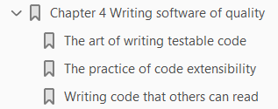
Writing software of quality
4

Slide 84
Intro

Slide 85
The art of writing testable code

Slide 86
The practice of code extensibility

Slide 87
Writing code that others can read

Slide 88
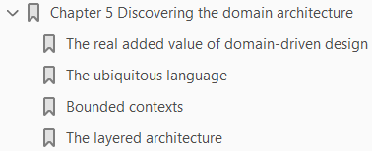
Discovering the domain architecture
5

Slide 89
Intro

Slide 90
The real added value of domain-driven design

Slide 91
The ubiquitous language

Slide 92
Bounded contexts

Slide 93
The layered architecture

Slide 94

The Presentation layer
6

Slide 95
Intro

Slide 96
User experience first

Slide 97
Realistic scenarios

Slide 98
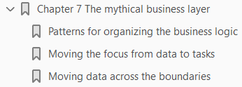
The mythical business layer
7

Slide 99
Intro

Slide 100
Patterns for organizing the business logic

Slide 101
Moving the focus from data to tasks

Slide 102
Moving data across the boundaries

Slide 103

Introducing Domain Model
8

Slide 104
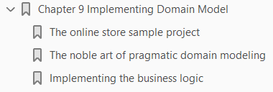
Implementing Domain Model
9

Slide 105
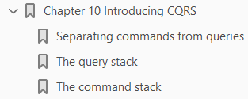
Introducing CQRS
10

Slide 106
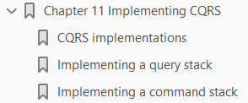
Implementing CQRS
11

Slide 107

Introducing event sourcing
12

Slide 108
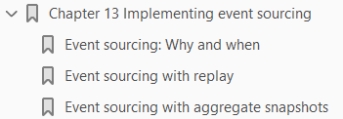
Implementing event sourcing
13

Slide 109
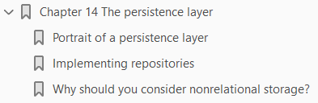
The persistence layer
14

